Slide 1
Conditional Generation by GAN
李宏毅
Hung-yi Lee
Notes:
Q: 可以做得很好? 為什麼?
Q: VAE 為何不好?
Q: unroll GAN有用嗎？

Slide 2
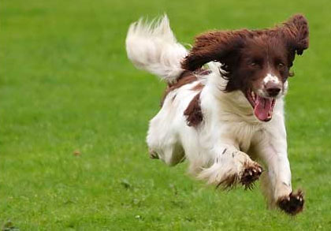
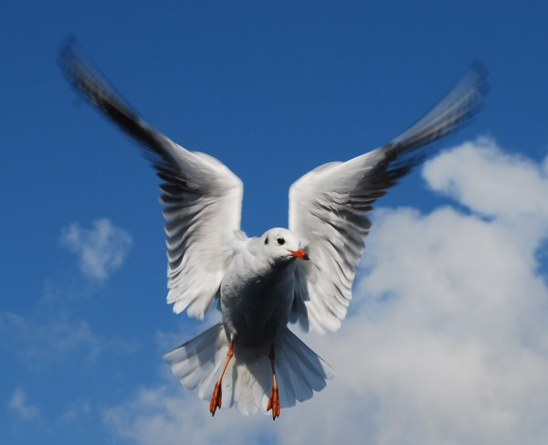
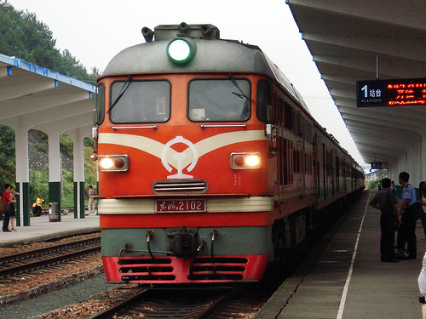
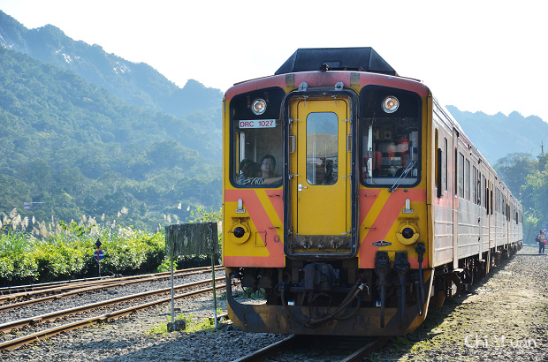
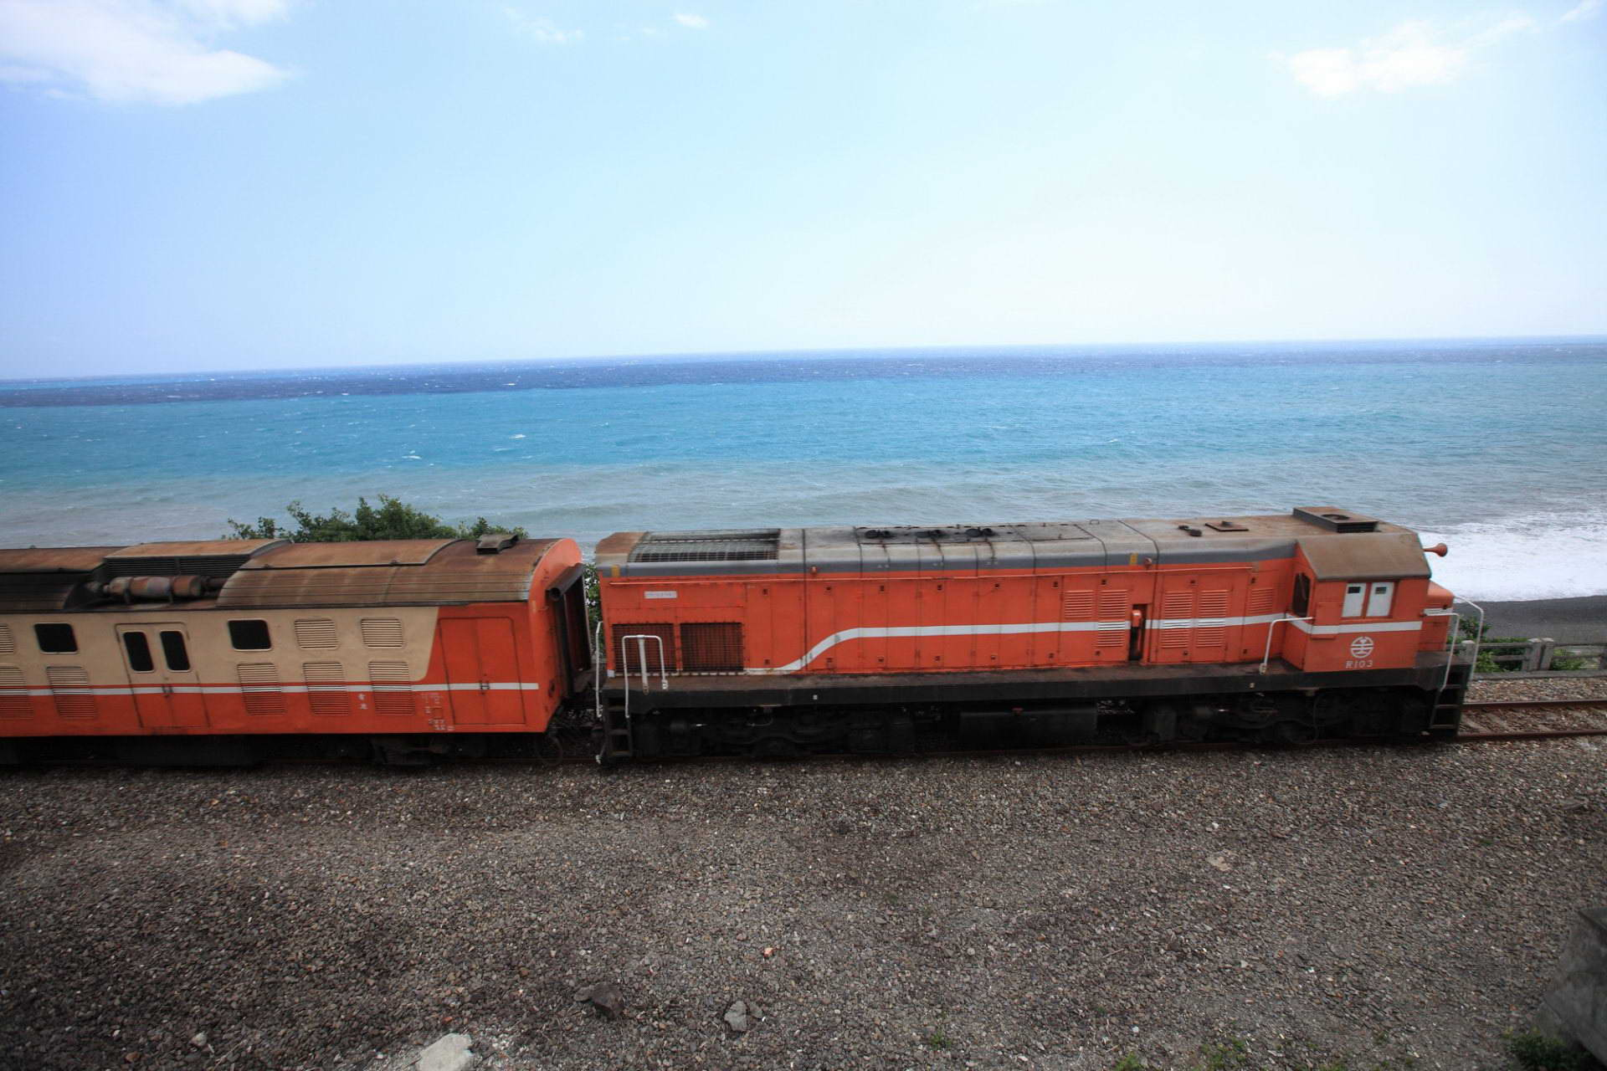
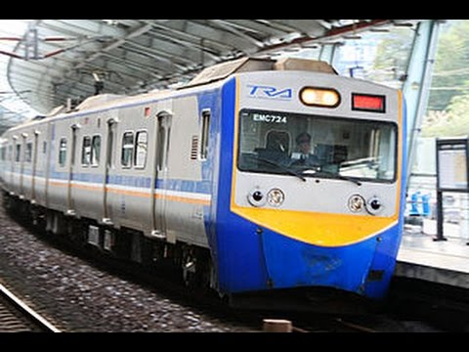
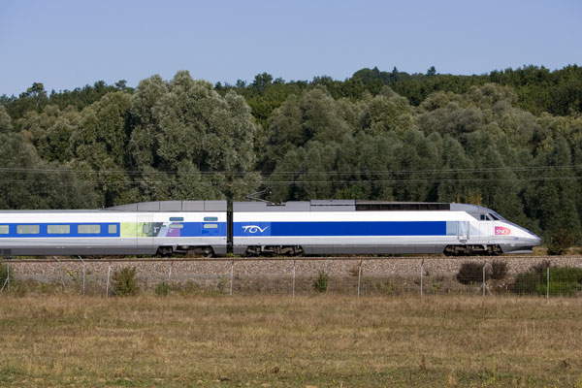
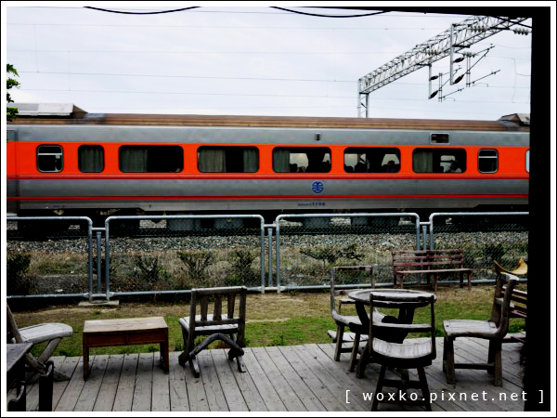
Text-to-Image
a dog is running
a bird is flying
Traditional supervised approach
Image
NN
c¹: a dog is running
as close as possible
Text: “train”
Target of NN output
A blurry image!

Slide 3


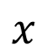
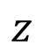
Conditional GAN
[Scott Reed, et al, ICML, 2016]
c: train
G
Image
x = G(c,z)
Normal distribution
$$z$$
x is real image or not
D
(original)
Generator will learn to generate realistic images ….
$$x$$
scalar
But completely ignore the input conditions.
Real images:
1
Generated images:
0

Slide 4
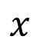
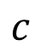
Conditional GAN
[Scott Reed, et al, ICML, 2016]
c: train
G
Image
x = G(c,z)
Normal distribution
$$z$$
$$c$$
D
(better)
x is realistic or not +
c and x are matched or not
scalar
$$x$$
(train , )
True text-image pairs:
1
(cat , )
0
(train , )
0

Slide 5
Conditional GAN - Discriminator
object x
Network
Network
score
condition c
Network
x is realistic or not +
c and x are matched or not
(almost every paper)
object x
Network
x is realistic or not
condition c
Network
c and x are matched or not
[Augustus Odena et al., ICML, 2017]
[Takeru Miyato, et al., ICLR, 2018]
[Han Zhang, et al., arXiv, 2017]
Notes:
https://arxiv.org/pdf/1802.05637.pdf

Slide 6

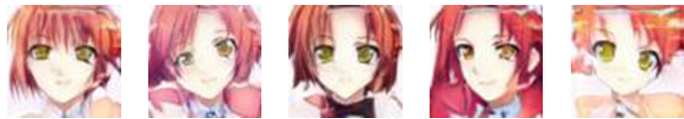
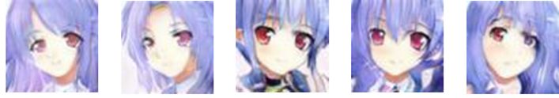
Conditional GAN
The images are generated by Yen-Hao Chen, Po-Chun Chien, Jun-Chen Xie, Tsung-Han Wu.
paired data
blue eyes
red hair
short hair
Collecting anime faces and the description of its characteristics
red hair, green eyes
blue hair, red eyes
Notes:
Provide 64x64

Slide 7
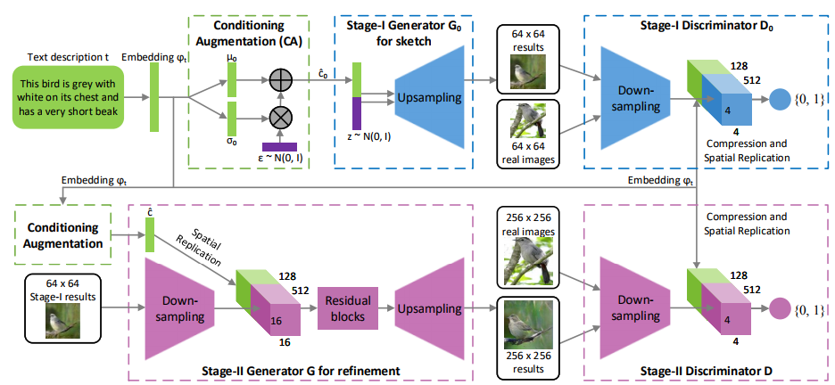
Stack GAN
Han Zhang, Tao Xu, Hongsheng Li, Shaoting Zhang, Xiaogang Wang, Xiaolei Huang, Dimitris Metaxas, “StackGAN: Text to Photo-realistic Image Synthesis with Stacked Generative Adversarial Networks”, ICCV, 2017

Slide 8
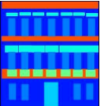
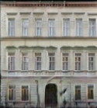
Image-to-image
$$c$$
G
x = G(c,z)
$$z$$
https://arxiv.org/pdf/1611.07004
Notes:
Façade門面,正面,外觀,虛設的外表
That is the facade of the Palace. 那是宮殿的正面

Slide 9
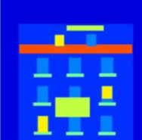
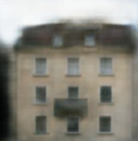
Image-to-image
Traditional supervised approach
Image
NN
as close as possible
Testing:
It is blurry because it is the average of several images.
input
close

Slide 10

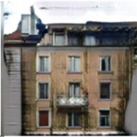
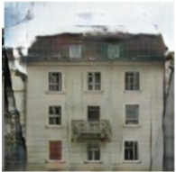
Image-to-image
Experimental results
G
Image
D
scalar
$$z$$
Testing:
input
close
GAN
GAN + close

Slide 11

Patch GAN
https://arxiv.org/pdf/1611.07004.pdf
score
score
score
D
D
D

Slide 12
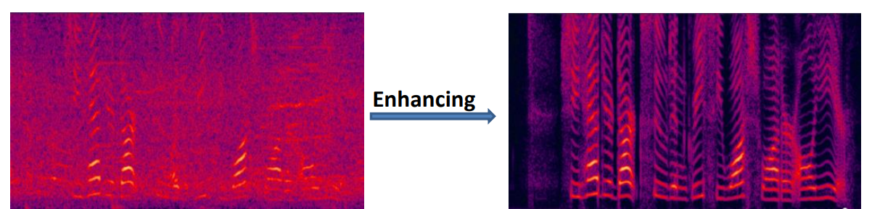
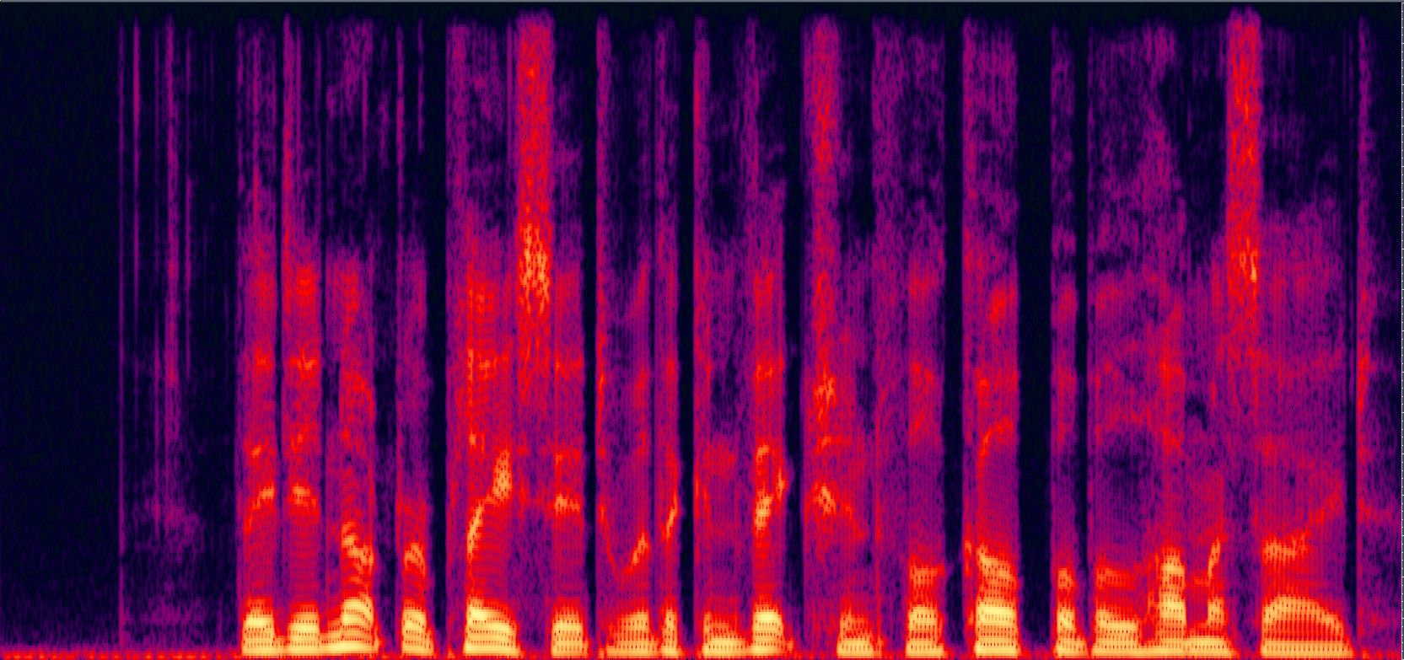
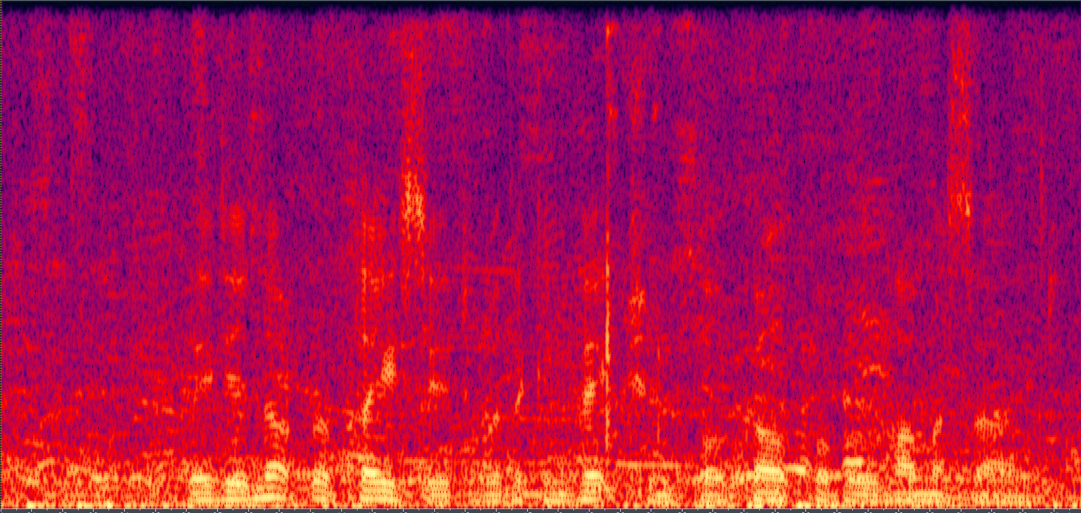

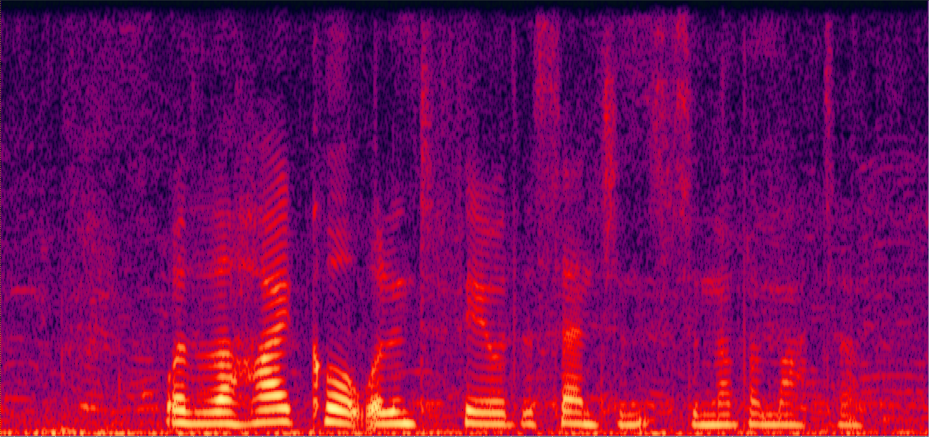
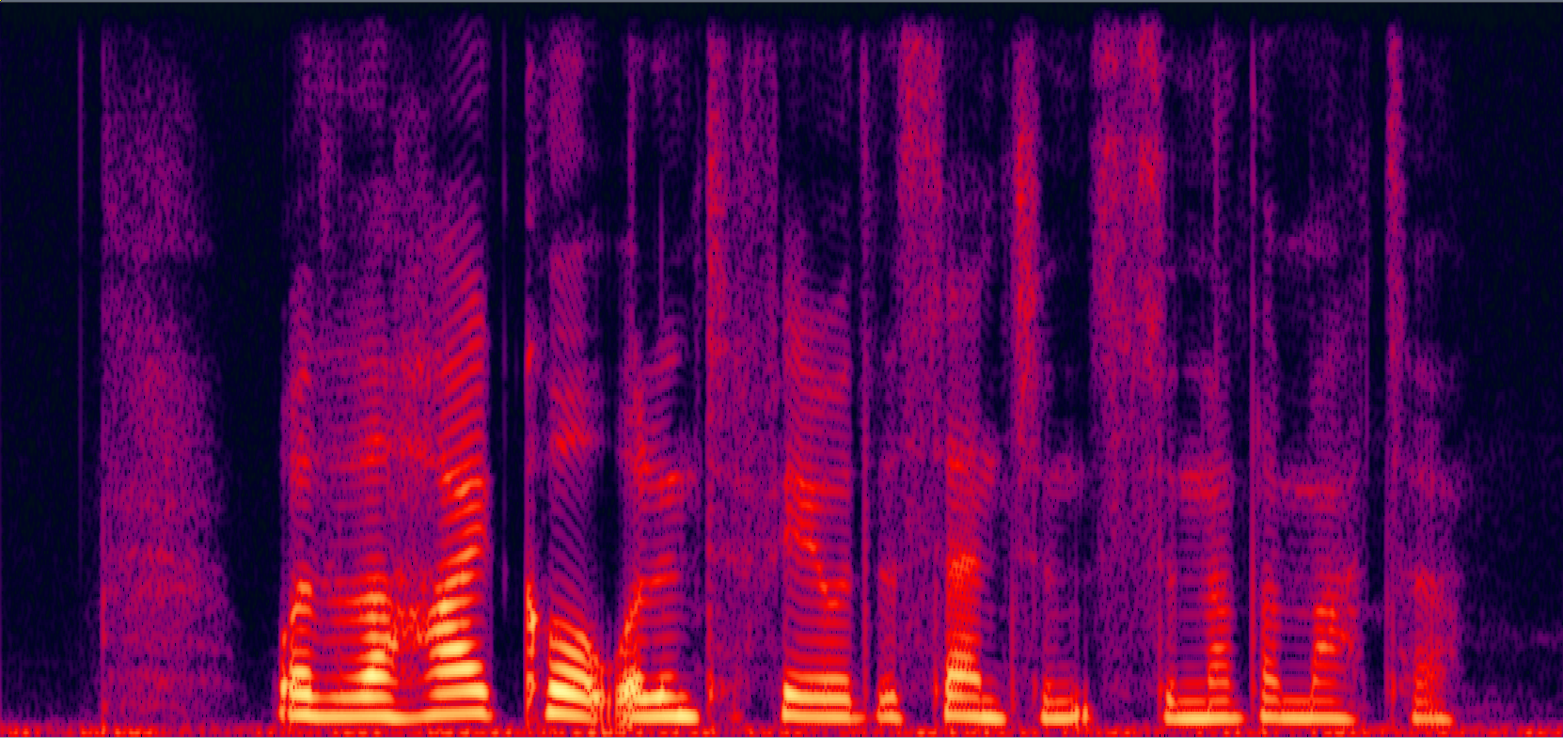
Speech Enhancement
Typical deep learning approach
Noisy
Clean
Using CNN
G
Output
Notes:
How many data do we need?
How about SEGAN?
Do we need dropout? On both training and testing?
Real pair and fake pair 怎麼弄

Slide 13
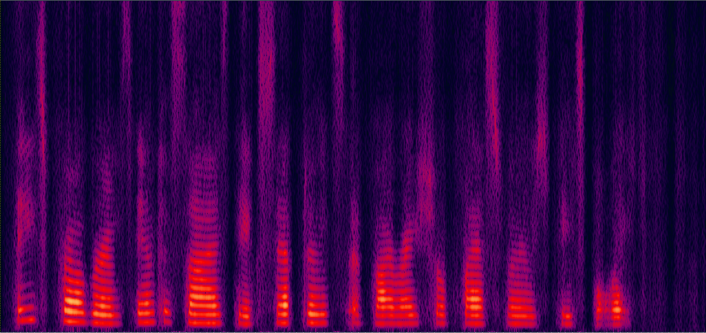
Speech Enhancement
training data
noisy
clean
Conditional GAN
noisy
output
clean
G
D
output
scalar
(fake pair or not)
noisy

Slide 14
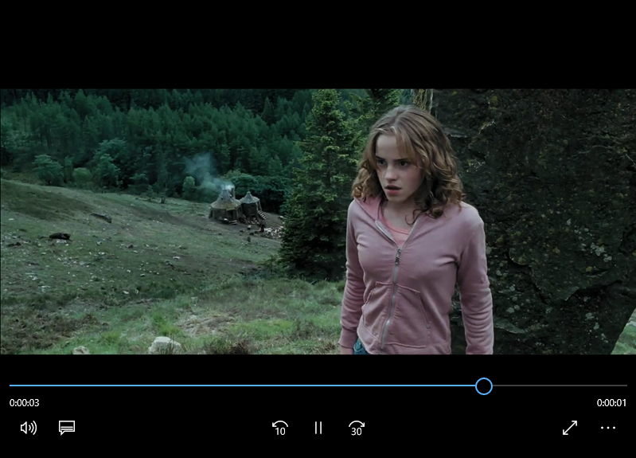
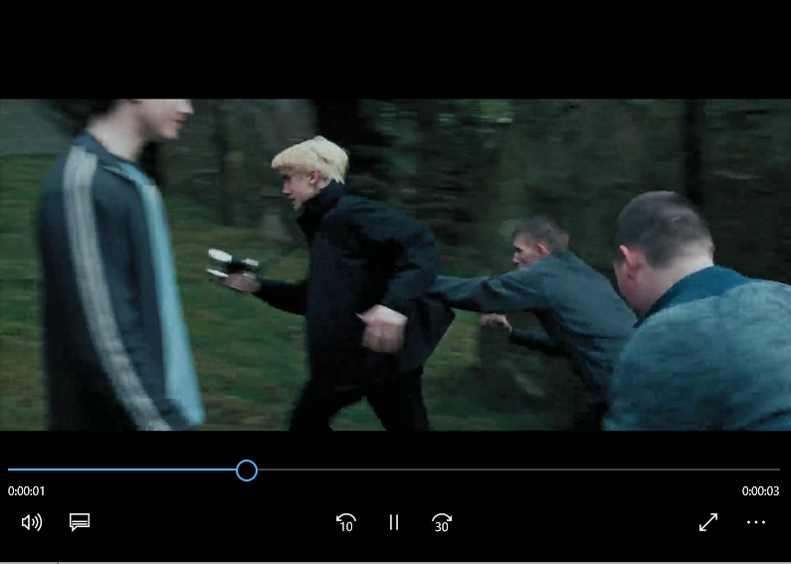
Video Generation
target
Minimize distance
Generator
Discriminator thinks it is real
Discrimi
nator
Last frame is real or generated
Notes:
Conditional version

Slide 15
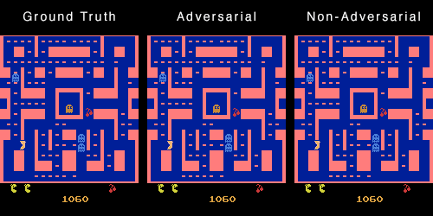
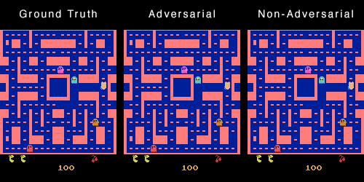
https://github.com/dyelax/Adversarial_Video_Generation

